Slide 1
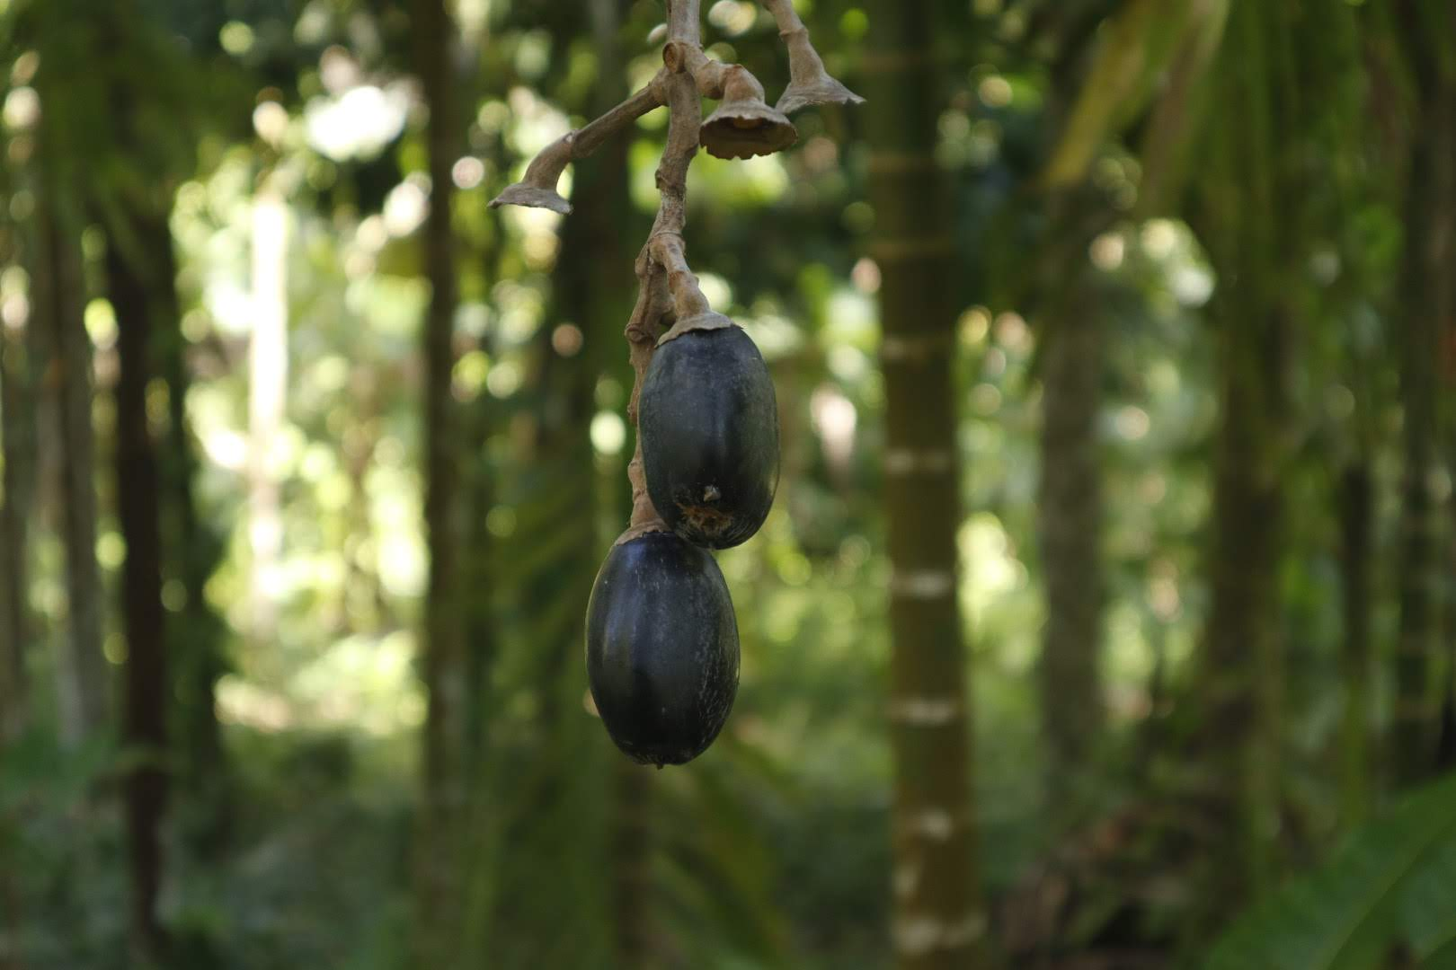
PNG Food & Nutrition Conference 2026
Conversations on
Improving Rural
Livelihoods
Value adding and marketing of
galip in Madang Province
Sim Sar¹, Tio Nevenimo², Solomon Sar¹, Lilly Sar¹³
¹ SISAL ² MVF ³ UoG
Session: Wed 1 Jul, 3:00-4:30pm — Haus Europa LT 2
Notes:
Before I begin, I want to acknowledge something important. This room is full of people who laid the foundation for the work I am about to share. Researchers from NARI. Partners from ACIAR. People who have been studying Canarium indicum long before SISAL existed.
My father, Dr. Sim Sar — who is in the room — was part of that journey. Dad was part of the galip programme at NARI, overseeing research in a management capacity. The data the NARI team generated, the varieties documented, the processing methods trialled — that is the foundation SISAL is built on. Thank you.
We also stand on the shoulders of others in this space. Frangipani Foods generously showed our team their operation in Keravat. They opened their doors, shared their processes, and helped us understand what commercial galip processing looks like at scale. That kind of collaboration is rare, and we are grateful.
And then there is MVF. And specifically, Tio Nevenimo — my co-author — played a critical role in getting SISAL under the MVF project — which we were initially not part of. Without his advocacy and belief in what we were trying to build, we would not be here today. Thank you, Tio.
So why am I here today? Not just to present data — you already have plenty of that. I am here to share a story.
When my father retired from formal duties, he could have chosen to rest. My mother, Dr. Lilly Sar — but like Dad, her heart has always been in community development. She is still at the University of Goroka. But they have always been driven by one thing: building communities. For them, galip is not just a crop. It is not just a commercial opportunity. It is a thread that connects generations — a link between grandparents and grandchildren, between villages and markets, between tradition and the future.
And speaking of legacy — my sons are here today. My eldest, and my youngest who is five. They remind me why this work matters. Dad built a bridge from research to village. My job is to make sure that bridge is still standing for them.
Dad always says: galip trees were planted by our ancestors, we harvest them today, and we plant new ones for those who come after us. That is not just agriculture. That is legacy.
So when they decided to pour their passion — and their retirement — into SISAL, it was never about building a business. It was about building a bridge. A bridge from the research done in this room to the village producers who need it most. A bridge from traditional knowledge to modern markets. A bridge from subsistence to possibility.
And that is what I want to share with you today — the SISAL story, our journey so far, and where we are heading.
My name is Solomon Sar. I co-run SISAL with my father Dr. Sim Sar, who is the Managing Director. SISAL is a social enterprise based in Megiar Village, Madang Province.
Let me begin.

Slide 2
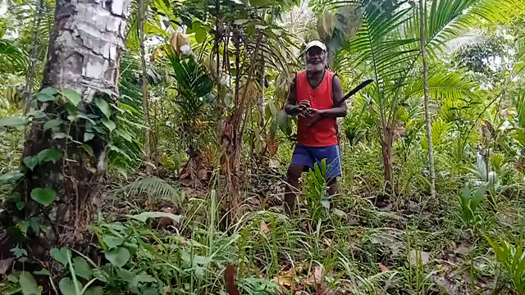
The Galip Opportunity
2
Key Facts
• Wild-harvested, zero inputs needed
• Priority crop under Vision 2050
• Growing domestic & export demand
• Seasonal peak: July – November
• Premium price, real livelihoods
Notes:
The Galip Opportunity
So why galip?
Canarium indicum grows wild across Madang, Morobe, East Sepik, ENB, and Island regions. No fertiliser. No irrigation. No clearing of land. The trees are already there, and for most of our history, the nuts have been part of village life for generations.
The market potential is real. We sell kernels at K179 to K200 per kilogram wholesale — volume-dependent. Retail packets at K11.50 at Papindo. CPL, Lae International Hotel — established buyers who reorder.
The government has identified galip as a priority crop under Vision 2050. But we are still at the very beginning.
— This is what we know from our data so far. Over 900 farmers recorded in our database. Tree density in some villages exceeds 200 trees per community. The resource base is there. The question is how we unlock it sustainably. SISAL is our answer to that question.

Slide 3
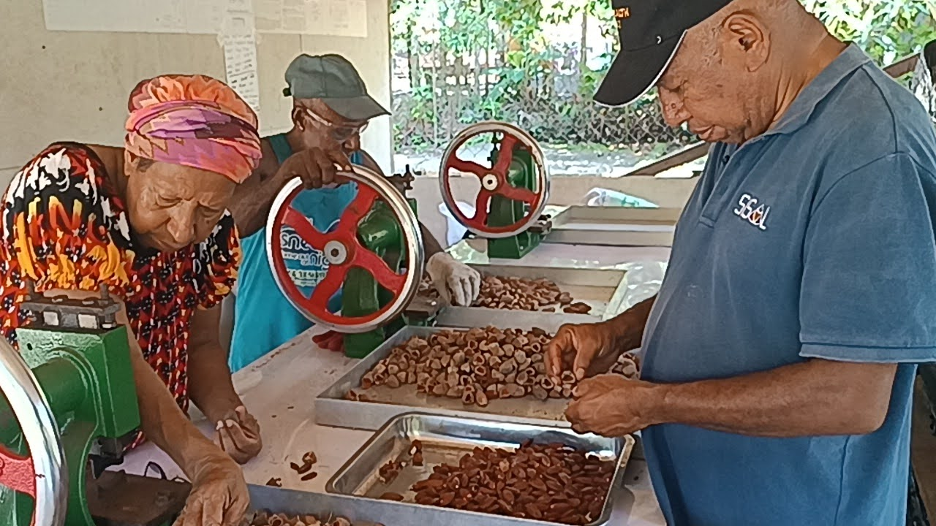
SISAL’s Journey
3
Pre-2024
10+ years community work
with galip farmers
SISAL registered
First processing in Megiar
2024
First client: CPL, Papindo, Foodmart,
Goroka
2025
19 SOPs, traceability,
HACCP prep underway
2026
Aligned with: Vision 2050 | MTDP IV | Constitution | Madang Plan
Notes:
SISAL's Journey
How did we get here?
SISAL was formally registered in 2024. But for Dad, galip goes back much further than SISAL. He grew up with this tree. I still remember my grandmother making Forong — a traditional pudding where galip is pulped with banana or taro into a paste, prepared during special occasions. That is the taste of home for our family.
2024 — we took the leap. Registered the company. Built first processing capacity in Megiar Village, Sumkar District, Madang Province. Right where the nuts grow.
2025 — proving the model. First clients: CPL, Papindo, Foodmart. Built the processing line: depulping, drying, cracking, roasting, packaging. Learned a lot. Made mistakes. Fixed them.
2026 — systems and scale. Nineteen standard operating procedures. Twenty quality forms. Batch numbering. Traceability from farmer to client. Moving from "getting it done" to "doing it right every time."
NARI has been our research backbone from the start. MVF brings the community development expertise. ACIAR supports the research linkages. We did not build this alone.
All of this — from the Forong my grandmother made to the SOPs we have today — is about turning traditional knowledge into modern livelihoods. And it is working.

Slide 4
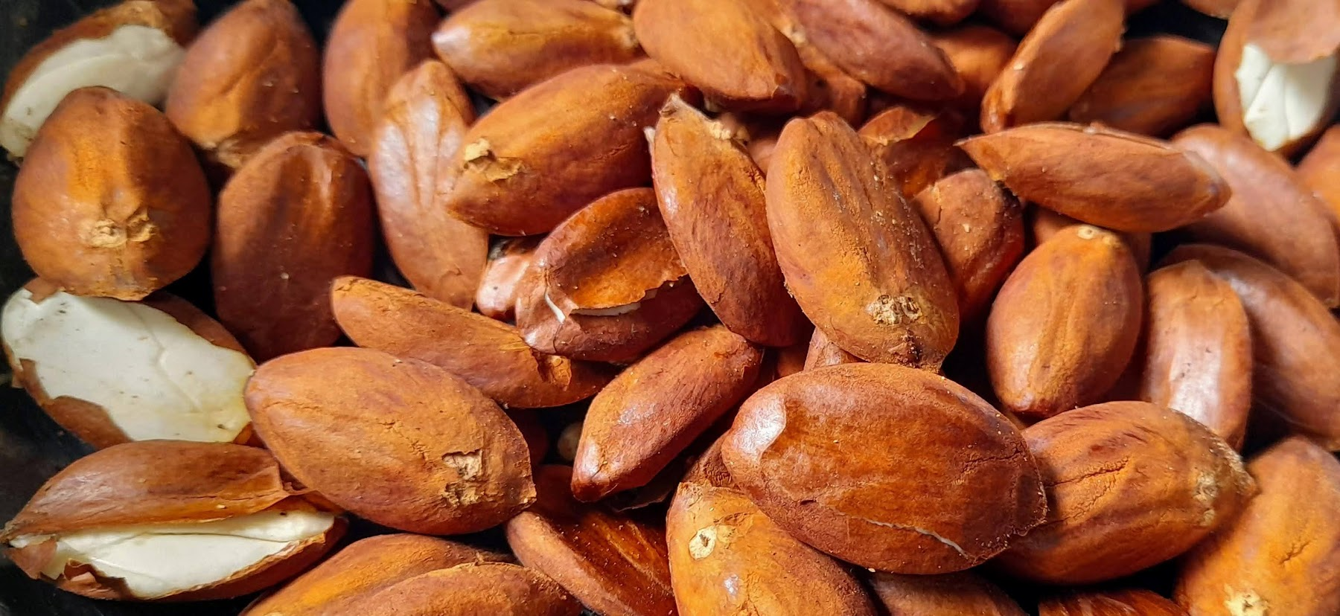
Village Collection Model
4
👤 LEAD COLLECTOR
🌰 KERNEL IN TESTA
🛒 Buys Nut-in-Pulp from farmers
🔄 Depulps, sells NIS to SISAL
💰 Sells at K1.50/kg NIS
💎 K10/kg premium
📦 Due to freight costs
↓
↓
🏢 SISAL
📍 Buys NIS (close locations)
🚛 KIT freight (Rai Coast)
👥 912+ Farmers | 🌏 20+ Villages
📋 Transparent pricing | ✋ No middlemen
Notes:
Sourcing: Village Collection Model
This is the engine of our operation — how galip actually gets from village trees to our facility.
We use a two-tier supply chain.
Lead Collectors. Community members we train and register. They buy nuts from farmers in their own village at K3.00 per kilogram for nut-in-shell, sell to us at K3.50. That 50 toea margin is their income for collecting, sorting, and keeping records. Every Lead Collector must submit a Purchase Record List — farmer names, villages, weights, signatures. No list, no sale. That is our traceability backbone.
Direct farmers — sell to us at village-gate prices. Same quality checks. Same record-keeping requirements.
Our database currently holds over 900 farmer records across more than 20 villages in Sumkar and Rai Coast districts. For cracked kernels — KIT — we pay K10 per kilogram. That is real money in a rural context.
The key insight: this model works because of transparency. Clear pricing cards, immediate payment, no middlemen. Farmers know what they will get before they pick a single nut.

Slide 5
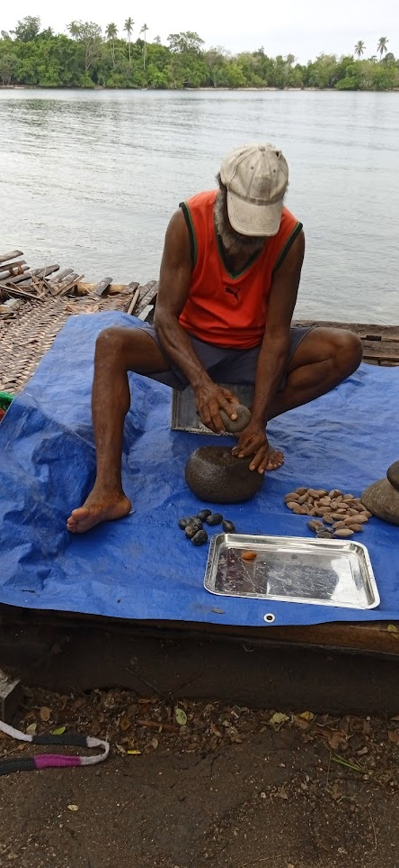
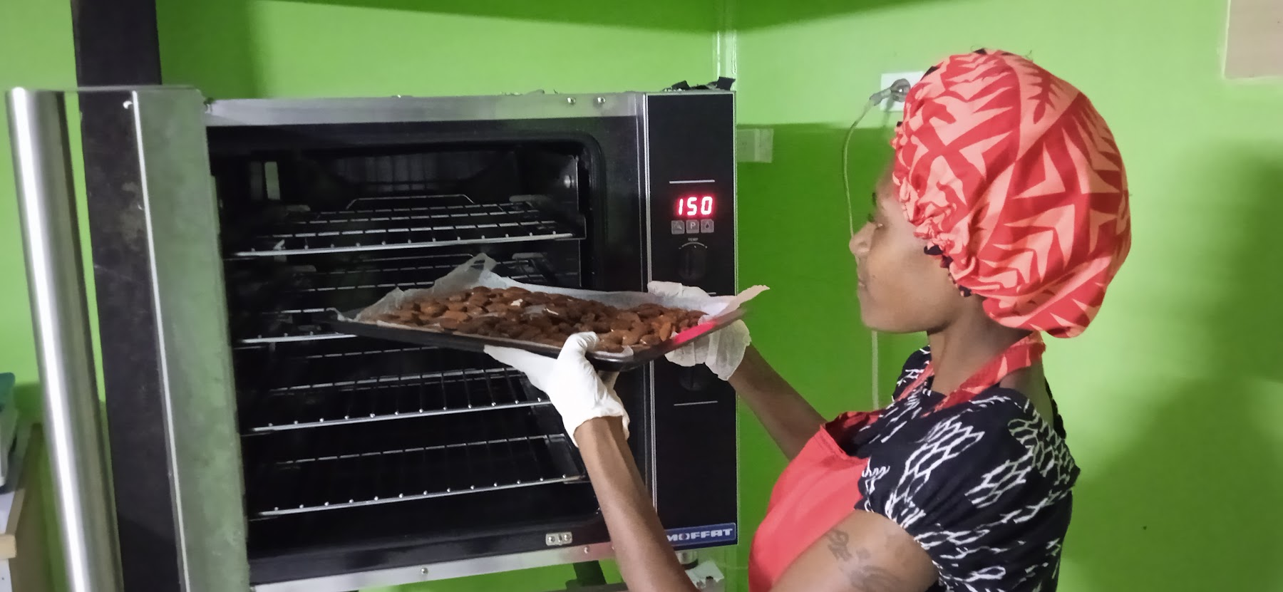
Processing: Village to Market
5
1.
Receive
& Depulp
2.
Sun Dry
3. Crack
& Shell
4. Roast
5.
Pack
& Dispatch
→
→
→
→
Notes:
Processing: Village to Market
Stage 1 — Receiving and depulping. Nut arrives in its outer pulp layer. We remove the pulp, inspect for mould or insect damage, check freshness — must be within five days of harvest. Pass? We pay and move to drying.
Stage 2 — Sun drying. Nut-in-shell dried on racks for a minimum of five days until moisture drops below 8%. Simple snap test: if it cracks, it is dry. If it bends, it needs more time. We shall use a moisture meter for verification.
Stage 3 — Cracking and de-shelling. Leather punch machine — simple, low-maintenance, suitable for village conditions. Kernel must be oven-dried within 48 hours of cracking to prevent rancidity. Time is critical.
Stage 4 — Roasting. Blanch at 60-80 degrees Celsius, then roast at 120 for about 30 minutes. Final moisture below 2.5%. Critical control point — get this wrong and the product deteriorates in weeks.
Stage 5 — Packaging and dispatch. Heat-sealed with zip-lock, batch number and best-before date printed. Full sign-off chain from production to dispatch. Every batch traceable back to the farmer.
We have developed a batch numbering system that traces every packet to its production date and source farmer. Critical control points at receiving, drying, and roasting. Nineteen SOPs and twenty forms supporting the whole process.
So what does this add up to? Let me show you the impact.

Slide 6
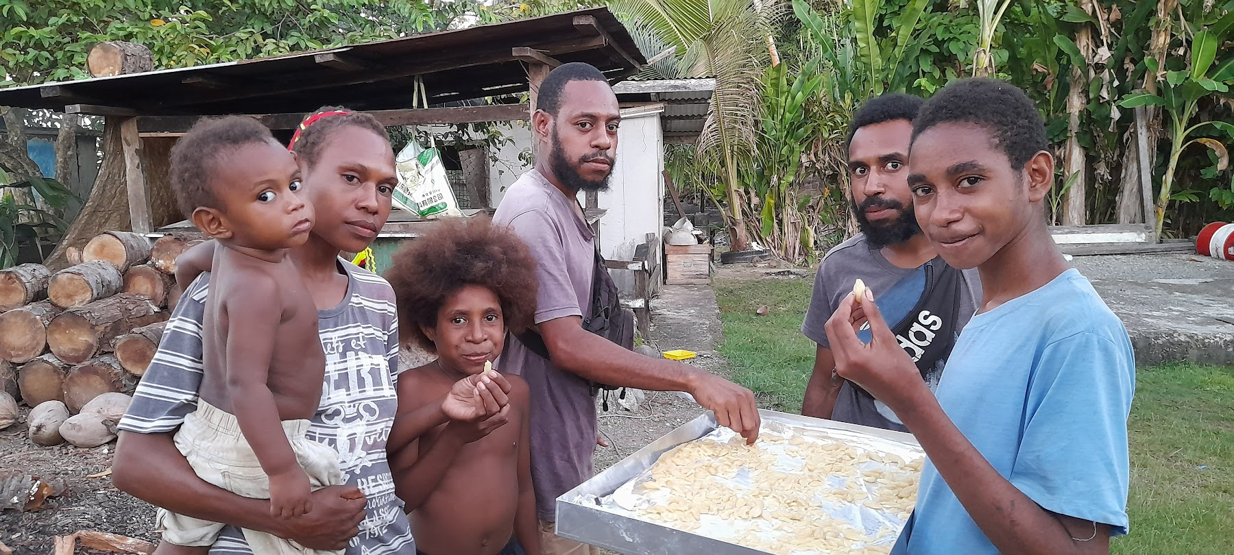
Impact at Scale
6
Community Value Created
Beyond the Numbers
SISAL is a social enterprise: 15% of gross revenue funds ABLE community programs.
1,000+
912+
20+
19
Households
Farmers
Villages
SOPs
Notes:
Impact at Scale
Over 900 farmers across 20 villages. Nineteen SOPs and twenty quality forms. K10 per kilogram for premium kernels directly in farmers' pockets.
But the broader story matters more.
SISAL is a social enterprise: 15 percent of gross revenue funds ABLE community programs. Every purchase creates possibility. Every packet sold funds grassroots work.
Many of our Collectors are women — direct income going to mothers and households. We also engage youth in training for processing, quality control, and business operations.

Slide 7
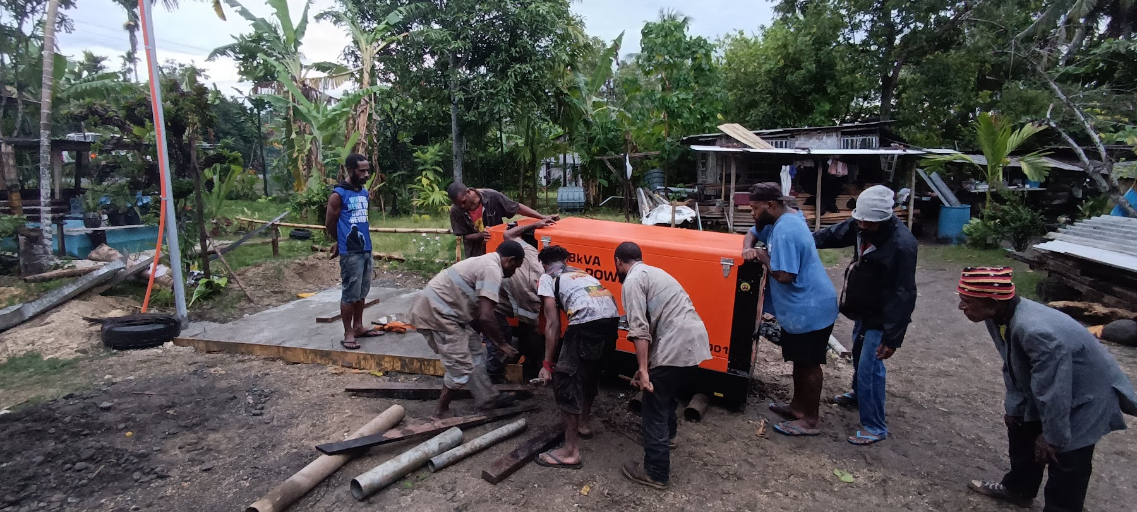
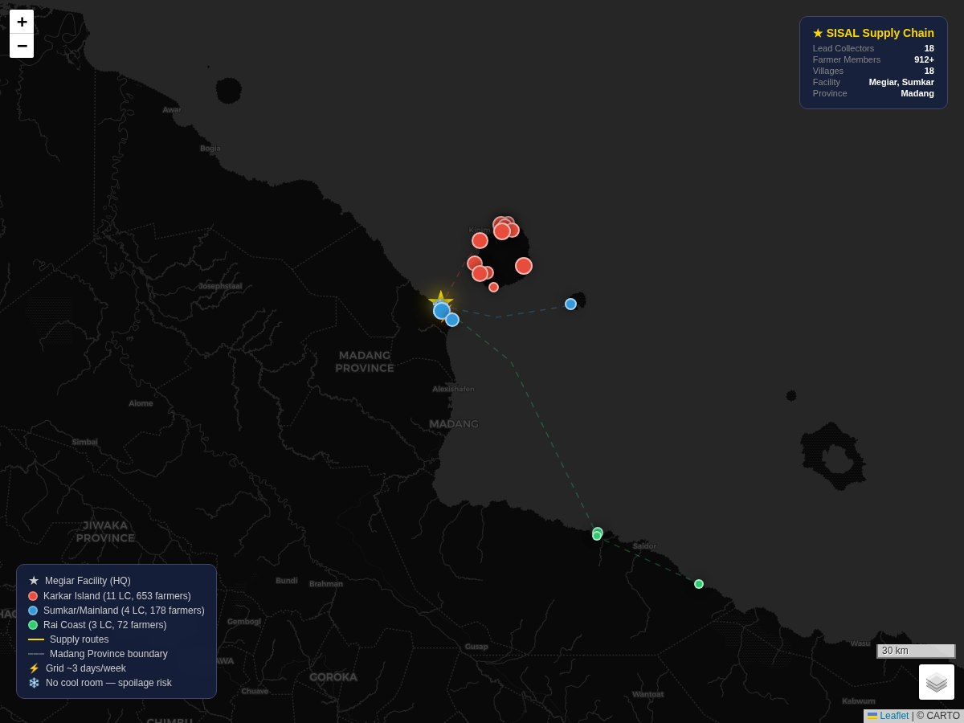
Challenges & Lessons
7
Challenges
• Seasonality (Jul-Nov peak)
• Remote infrastructure
• Quality consistency
• Market education needed
Lessons Learned
• Start simple: paper forms first
• Price transparency = trust
• Lead Collector model has potential
• Moisture meter essential for quality control
• Community trust drives participation
Notes:
Challenges & Lessons
I will be honest — it has not all been smooth.
Our biggest challenge is storage. Galip is seasonal — peak from July to November — and we currently lack the capacity to store either nut-in-shell or processed kernels at scale. Nut-in-shell requires cool-room conditions or a proper drying shed; without them, we have lost significant stock through spoilage. Processed kernels need cool, dry storage, but running a generator is expensive, and main grid electricity is unreliable — we average about three days per week. That is the single biggest constraint on our growth.
But here is what we have learned: start simple. Paper forms before digital — farmers are comfortable with paper, and we get reliable data. Price transparency builds trust. The Lead Collector model has potential, but the collectors have not yet fully owned it as their own business supplying SISAL — that is something we are actively working on. And the moisture meter? Learning from the NARI team is the best investment we ever made — it will solve more quality arguments than anything.
Most importantly: we have learned that transparency builds trust. Farmers engage when they see clear value — fair prices, immediate payment, and a direct line from their nuts to a finished product on a shelf.

Slide 8
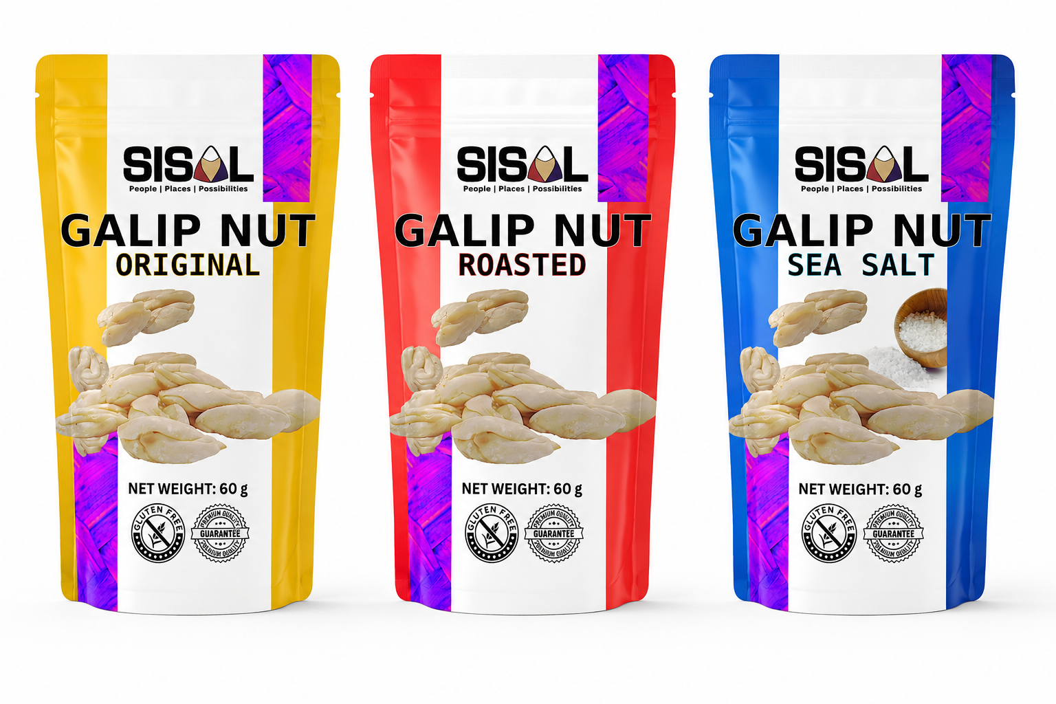
The Road Ahead
8
1
Digital Systems
2
HACCP Certification
3
Export Market
Traceability, inventory, ordering platform
Food safety systems and audit prep
Protocols, buyers, logistics pathway
Notes:
The Road Ahead
Where are we heading?
One — Digital Systems. Implementing supply chain traceability, inventory management, and an online ordering platform.
Two — HACCP Certification. Formalising our food safety systems and preparing for internal audit.
Three — Export Market. Developing compliance protocols, securing buyers, and optimising our logistics pathway.
Ambitious agenda. But we have the foundations.

Slide 9

Thank You
Solomon Sar
Operations Manager, SISAL
solomon.sar@gmail.com
+675 7285 7237
Megiar, Sumkar, Madang Province
"Every Purchase Creates Possibility"
Scan for slides, recipe card & more
sisalpng.com
Notes:
Thank you all for being part of this conversation.
If you want to follow up — try our galip, partner with us, invest in the supply chain, or just learn more — please reach out. My email and phone are on the screen. Sim and Tio are in the room too — grab us during the break.
As we say at SISAL: Every Purchase Creates Possibility.
If you would like to download this presentation, our company profile, recipe card, and contact details — scan the QR code on the screen. sisalpng.com — where you will find slides, recipes, and more.
Thank you.

